Slide 1

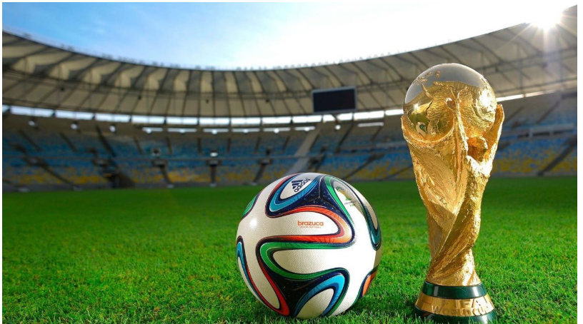

FIFA World Cup Analyasis
Predicting Football Player Performance:
Project By :
1. Amarnath Shende
2. Ragini Mahajan
3. Aarti Patil
4. Sahil Survase
5. Harshad Patil

Slide 2

Overview
This presentation explores sports analytics in football Worldcup. Discover why predicting player performance is crucial. We will discuss teams performance, most popular worldcup,advatage of home ground etc. These include player,teamwise valuation and on-field contribution.

Slide 3

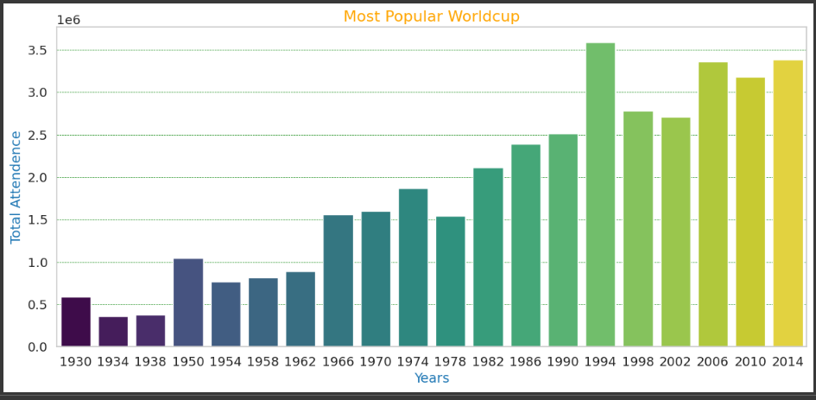
Popular Worldcup By Year
Popular Worldcup

Slide 4
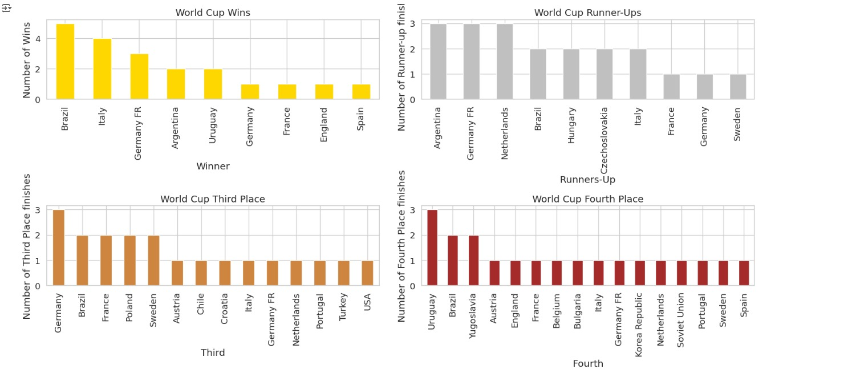
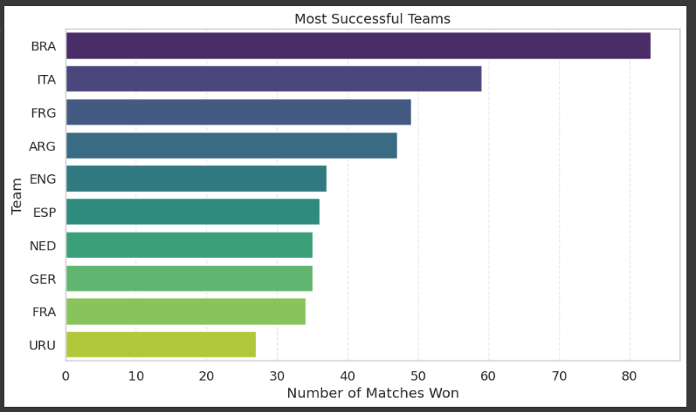
Successful Teams

Slide 5
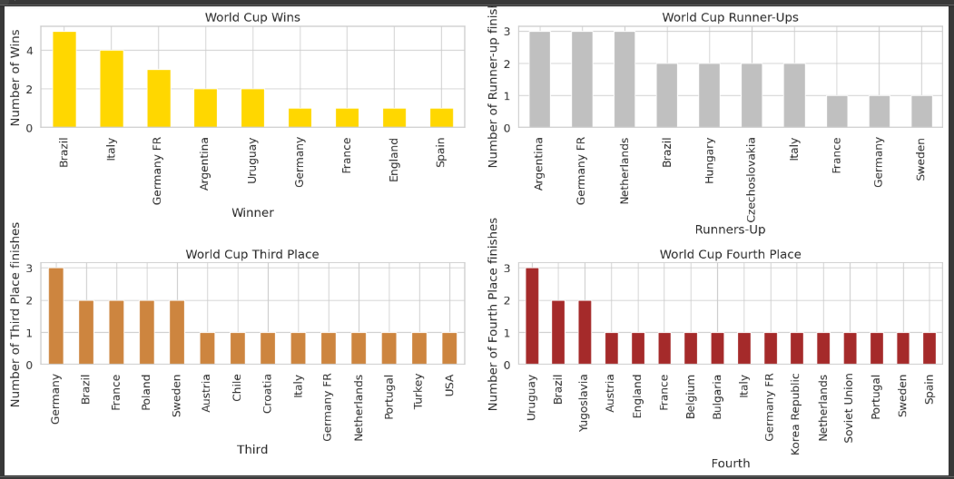

Slide 6
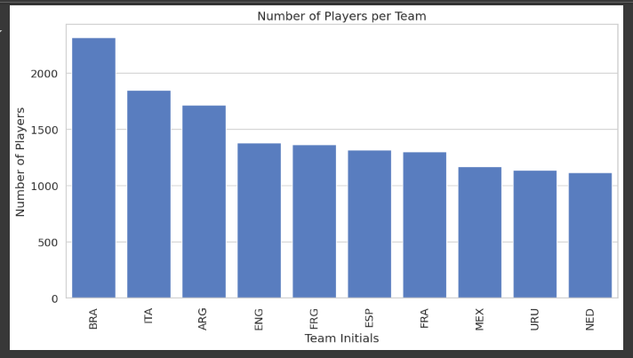
Player Count as per Team

Slide 7
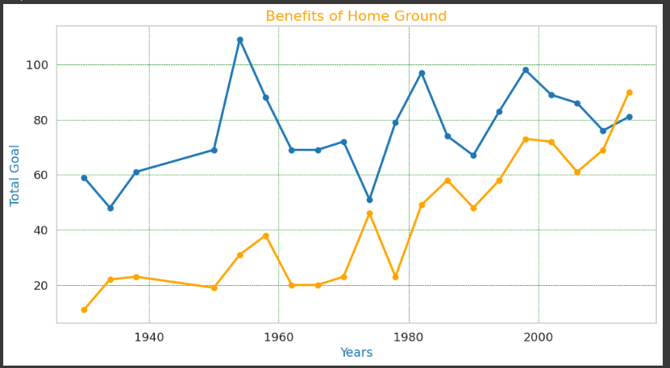
Benefits of Home Ground

Slide 8
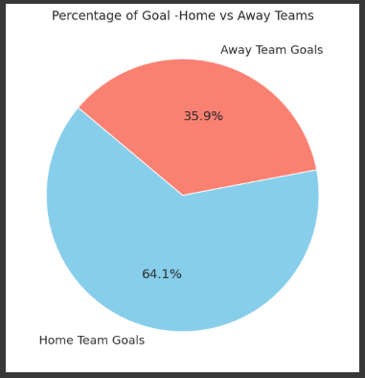
Home- Away Team Goals

Slide 9

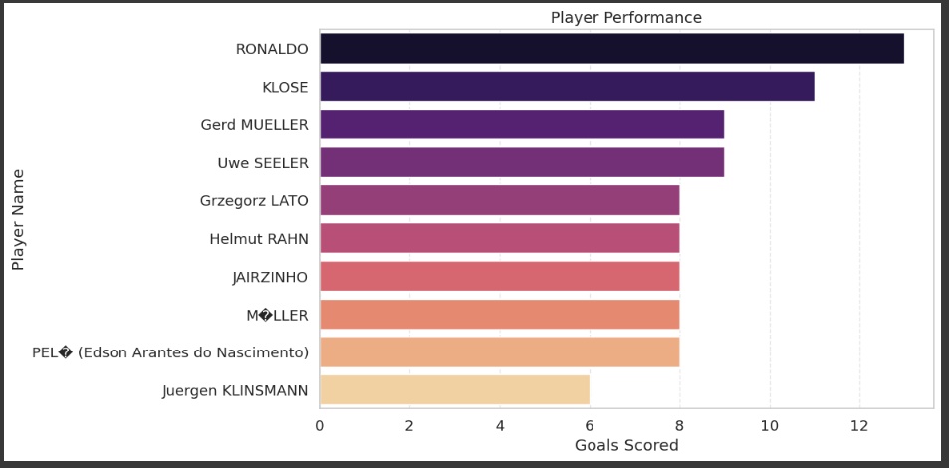
Payer Perpormance

Slide 10
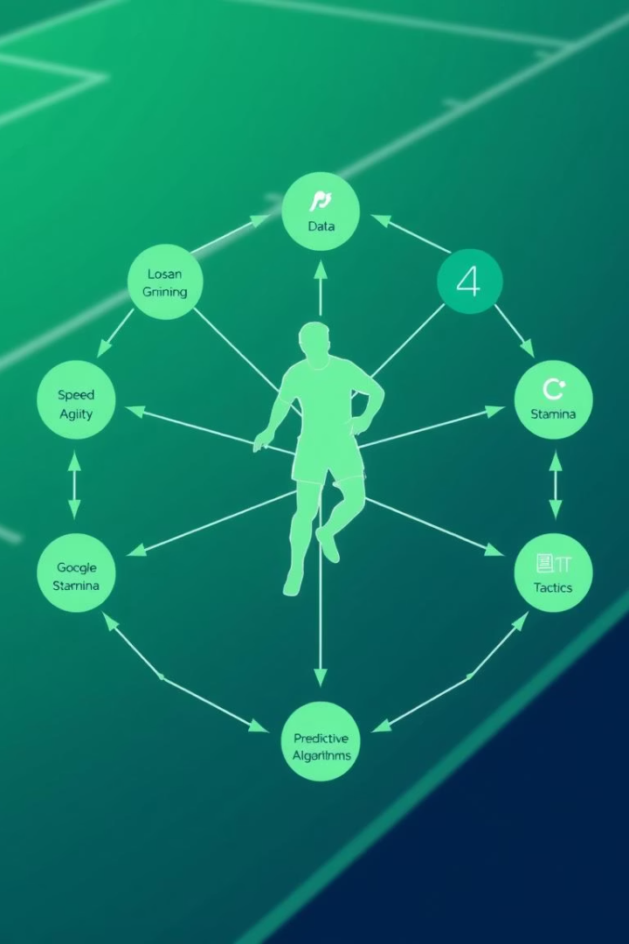
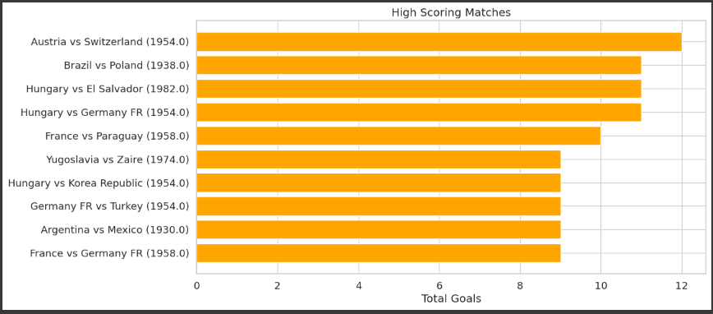
High Scoring Matches Due Wining Conditions

Slide 11
Summery
This project analyzes historical FIFA World Cup data to uncover patterns in team performance, player contributions, and match outcomes. Using datasets on tournaments, matches, and players, we explore popular World Cups, successful teams, player participation, and the impact of home-ground advantage. Key insights include high-scoring matches, win conditions, and team-wise player analysis. This study demonstrates how sports analytics can be used to predict player performance, support strategic decisions, and enhance our understanding of football at the global level.

Slide 12

Thank You

